Slide 1
CCMUN II Rule of Porcedure

Slide 2
Structure
Roll Call+
Opening Speech
Lobbying
Debating
Voting

Slide 3
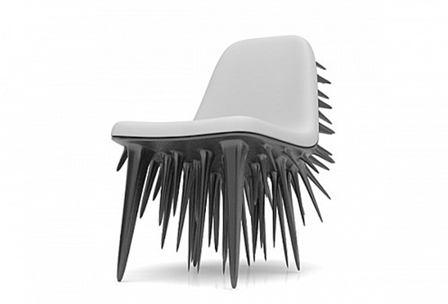
When The conference starts…
“The house will
now come to order. Delegates please be seated.”

Slide 4
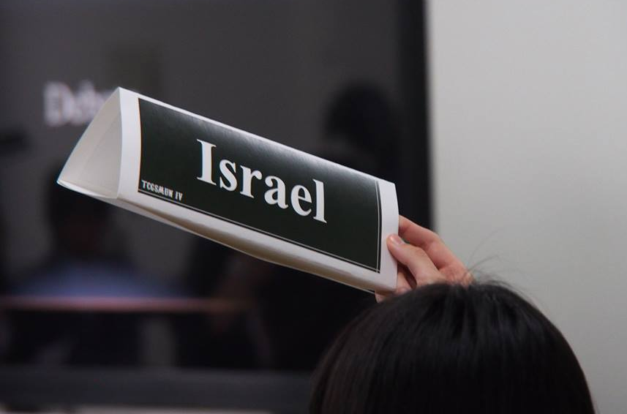
Roll Call
“The chair will now conduct Roll Call. Delegates who are recognized, please raise your placard high and say ‘’Present”.
or “present and voting”.
Roll Call+
Opening Speech
Lobbying
Debating
Voting
(Countries will be called out in alphabetical order.)

Slide 5
OPENING SPEECH
An opening speech is a statement to let other countries know your position towards the issue at hand.
Roll Call+
Opening Speech
Lobbying
Debating
Voting

Slide 6
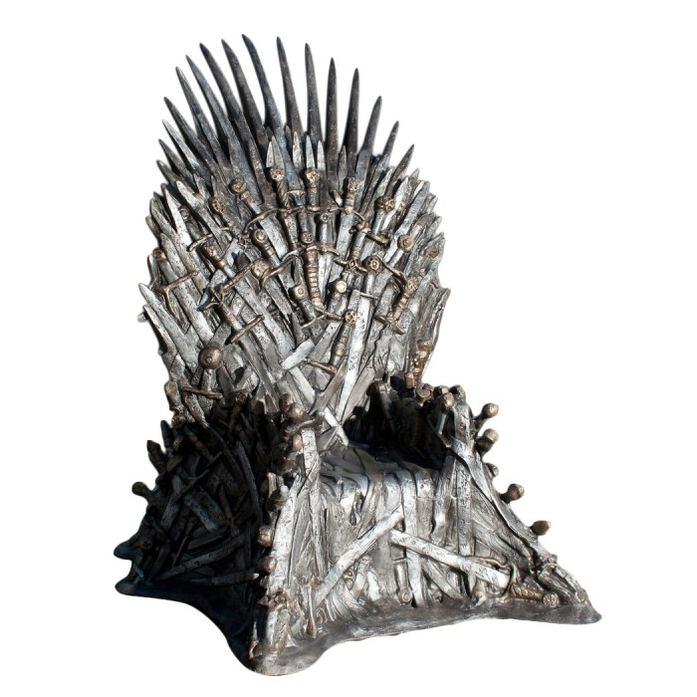
We’ll now start the opening speeches, delegates will be called in a group of three. Delegate of ( ), ( ), and ( ) you have been recognized in that order, please approach the podium.
Roll Call+
Opening Speech
Lobbying
Debating
Voting

Slide 7
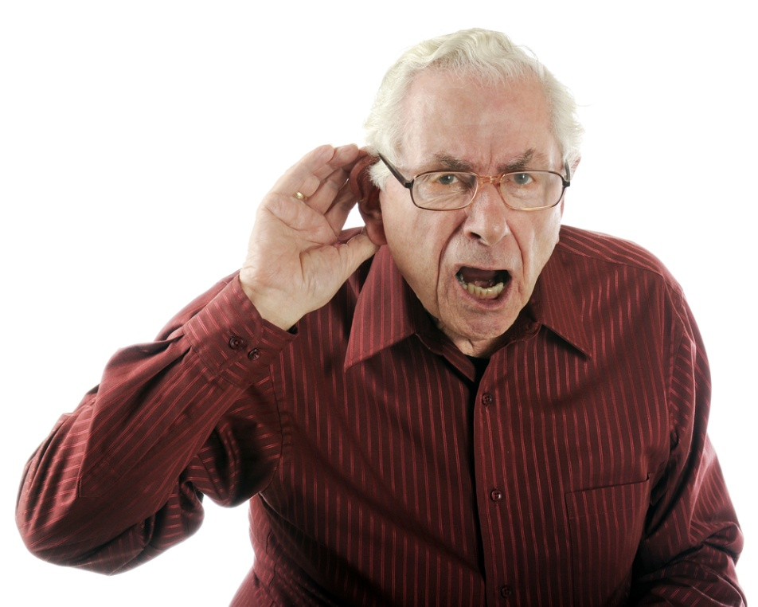
Points of personal privilege
Audibility!!!!!!
Roll Call+
Opening Speech
Lobbying
Debating
Voting
You are only allowed to interrupt a delegate on the podium when you have a point of personal privilege.

Slide 8
Rights of reply
This is a perfect time for delegates to say who they are going to be alliances with.
(Rights of reply must be statements, not questions.)
Roll Call+
Opening Speech
Lobbying
Debating
Voting

Slide 9
LOBBY TIME
Time to get up and meet other countries with similar stances over the topic!! Try to talk to as many countries as you can!!
Roll Call+
Opening Speech
Lobbying
Debating
Voting

Slide 10
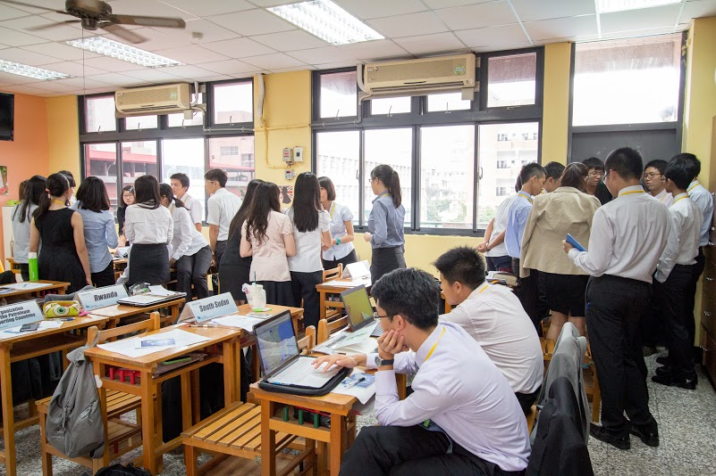
Countries should gather and discuss the details of the draft resolution in order to make the most comprehensive and detailed resolution.

Slide 11
After your country bloc finishes the draft resolution, print it out and show it to your chair who will check the format, and then bring it to the approval panel for it to be approved and stamped, then hand it back to the chair to have it printed out.

Slide 12
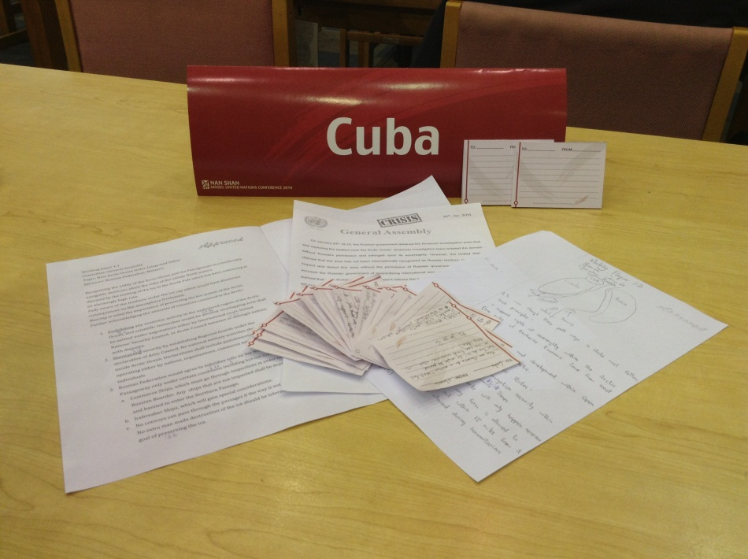
“Lobbying time has elapsed, delegates
please return to your seats.”
By this time, your draft resolutions must be done, approved, sent to the and printed out. The draft resolutions will now be distributed.

Slide 13
DEBATE TIME~

Slide 14
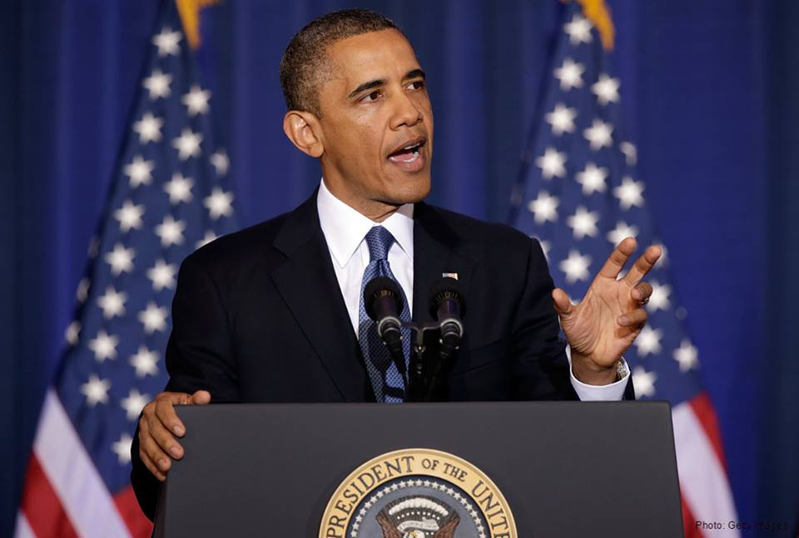
The chair will call on the main submitter of the draft resolution to read out the clauses and make a persuasive speech.

Slide 15
Persuasive speech?
The meaning of a persuasive speech is to convince all delegates in the house to agree to your stance.

Slide 16
After persuasive speech…
Points of information!!!!
Points of Information are entertained only with the speaking delegate’s permission. If the delegate has opened himself/herself to POIs, feel free to raise your placard to be recognized, after the chair recognizes you, feel free to ask any question you have regarding the DR. It is important to remember that POIs must be in question form and you can only ask one at a time, unless the chair grants you a follow-up (max one follow-up).

Slide 17
I really want to vote for this resolution, but I think there is something that my country is not in favor of. What should I do???

Slide 18
You can slightly amend this draft resolution by submitting an amendment to the chair ☺

Slide 19
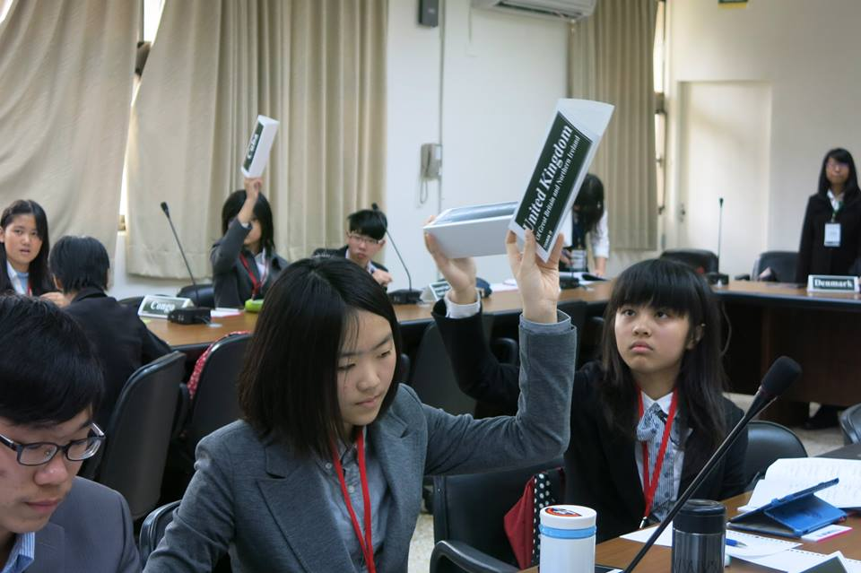
VOTE FOR AMENDMENTS
Delegates are reminded that there are no abstentions when voting for amendments.

Slide 20
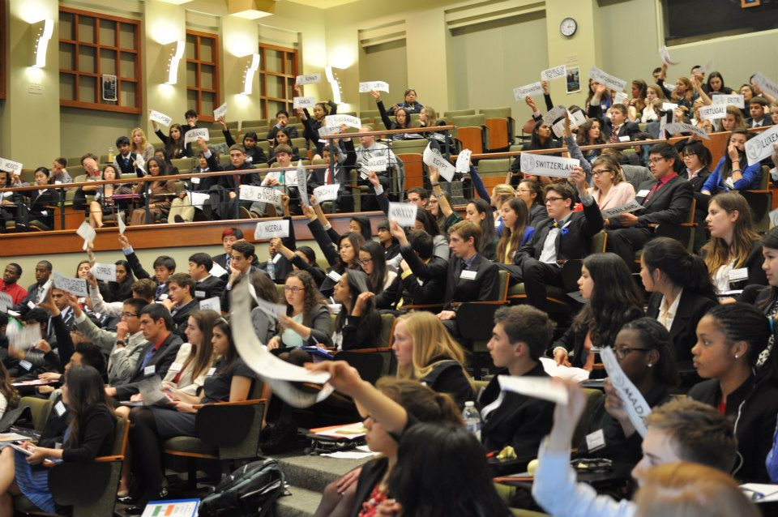
Voting for the Draft Resolution!!
“You can either vote FOR, AGAINST or ABSTAIN”

